Slide 1
CO2 Topics

Slide 2
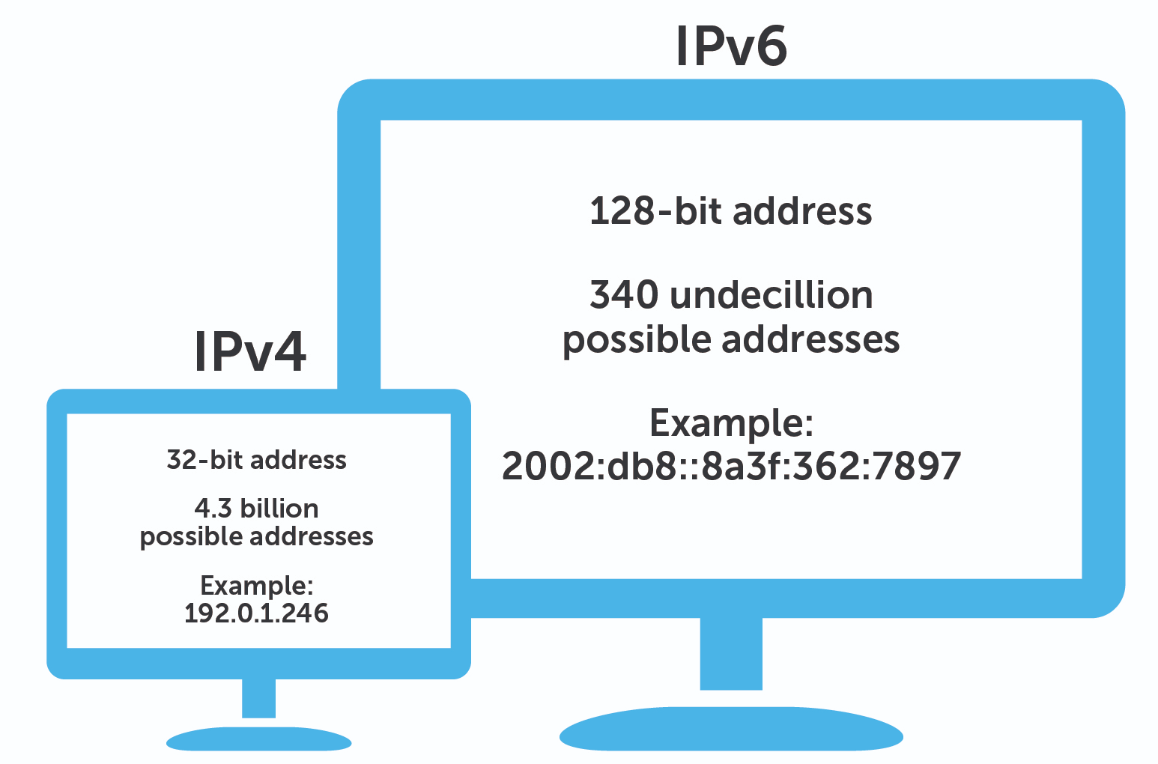
IPv4 VS Ipv6

Slide 3
Internet Protocol v4
IP stands for Internet Protocol and v4 stands for Version Four (IPv4). IPv4 was the primary version brought into action for production within the ARPANET in 1983. IP version four addresses are 32-bit integers which will be expressed in decimal notation.
Example- 192.0.2.126 could be an IPv4 address.
Parts of IPv4
Network part: The network part indicates the distinctive variety that’s appointed to the network. The network part conjointly identifies the category of the network that’s assigned.
Host Part: The host part uniquely identifies the machine on your network. This part of the IPv4 address is assigned to every host. For each host on the network, the network part is the same, however, the host half must vary.
Subnet number: This is the nonobligatory part of IPv4. Local networks that have massive numbers of hosts are divided into subnets and subnet numbers are appointed to that.

Slide 4
Characteristics of IPv4
IPv4 could be a 32-Bit IP Address.
IPv4 could be a numeric address, and its bits are separated by a dot.
The number of header fields is twelve and the length of the header field is twenty.
It has Unicast, broadcast, and multicast style of addresses.
IPv4 supports VLSM (Virtual Length Subnet Mask).
IPv4 uses the Post Address Resolution Protocol to map to the MAC address.
RIP may be a routing protocol supported by the routed daemon.
Networks ought to be designed either manually or with DHCP.
Packet fragmentation permits from routers and causing host.

Slide 5
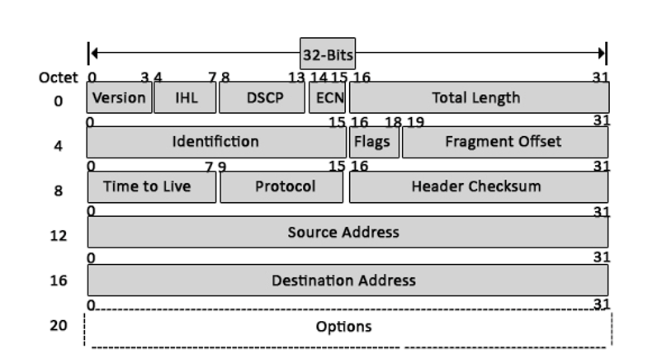
IPv4 Header Format
Version
Internet Header Length
Type of Service (Differentiated Services Code Point )
Explicit Congestion Notification
Total Length
Identification
Flags
Fragment Offset
Time to live
Protocol
A checksum of header
Source Address
Destination Address
Options

Slide 6
IPv4 Header Format Component
Version: The first header field is a 4-bit version indicator. In the case of IPv4, the value of its four bits is set to 0100, which indicates 4 in binary.
Internet Header Length: IHL is the 2nd field of an IPv4 header, and it is of 4 bits in size. This header component is used to show how many 32-bit words are present in the header. As we know, IPv4 headers have a variable size, so this is used to specify the size of the header to avoid any errors. This size can be between 20 bytes to 60 bytes.
Type of Service: ToS is also called Differentiated Services Code Point or DSCP. This field is used to provide features related to service quality, such as for data streaming or Voice over IP (VoIP) calls. It is used to specific how a datagram will be handled.
Explicit Congestion Notification: ECN is used to send notifications to the sender or receive in situations where network congestion happens. This is an optional feature of IPv4 can; if one of the endpoints don’t support it, it is not used.

Slide 7
Total Length: This field’s size is 16 bit, and it is used to denote the size of the entire datagram. The minimum size of an IP datagram is 20 bytes, and at the maximum, it can be 65,535 bytes. Practically, all hosts are required to be able to read 576-byte datagrams. If a datagram is too large for the hosts in the network, fragmentation is used, which is handled in the host or packet switch.
Identification: The identification or ID field in a packet can identify an IP datagram’s fragments uniquely. Some have suggested using this field for other things such as adding information for packet tracing etc.
Flags: flag in an IPv4 header is a three-bit field that is used to control and identify fragments. The following can be their possible configuration:
Bit 0: this is reserved and has to be set to zero
Bit 1: DF or do not fragment
Bit 2: MF or more fragments.
Fragment Offset: This field is 13 bit long in length, and it is measured by blocks that units of 8-byte blocks. These are used to specify the offset of a fragment relative to the start of the IP datagram, which when it was not fragmented. As you can expect, the first offset of a fragment is always set to zero. The maximum possible offset is ( 2¹³-1 ) * 8 = 65528, but it is more than the maximum possible IP Packet length, which is 65,535 bytes long with the length of a header added in.

Slide 8
Time to live: Time to live (or TTL in short) is an 8-bit field to indicate the maximum time the datagram will be live in the internet system. The time here is measured in seconds, and in case the value of TTL is zero, the datagram is erased. Every time a datagram is processed, it’s Time to live is decreased by one second. These are used so that datagrams that are not delivered are discarded automatically. TTL can be between 0 – 255.
Protocol: This is a filed in the IPv4 header reserved to denote which protocol is used in the later (data) portion of the datagram. For Example, number 6 is used to denote TCP and 17 is used to denote UDP protocol.
The header’s checksum: The checksum field is of 16-bit length, and it is used to check the header for any errors. The header is compared to the value of its checksum at each hop, and in case the header checksum is not matching, the packet is discarded. Keep in mind that this is only for the header, and its protocol handles the data field. UDP and TCP, for example, have their own checksum fields.
Source Address: It is a 32-bit address of the source of the IPv4 packet.
Destination Address: the destination address is also 32 bit in size, and it contains the receiver’s address.
Options: This is an optional field of the IPv4 header. It is used only when the value of IHL is set to more than 5. These options contain values and settings for things related to security. Record route and time stamp etc. You will find that the list of options component ends with an End of Options or EOL in many cases.

Slide 9
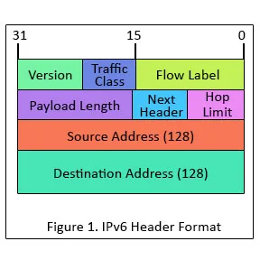
IPv6 Header Format Component

Slide 10
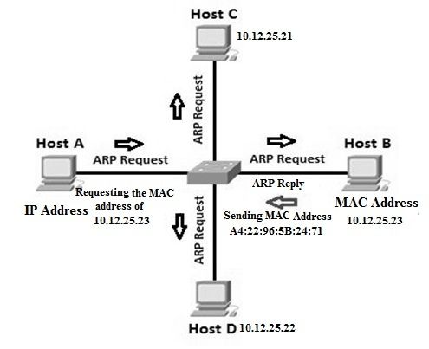
Address Resolution Protocol : Working

Slide 11
ARP Working

Slide 12
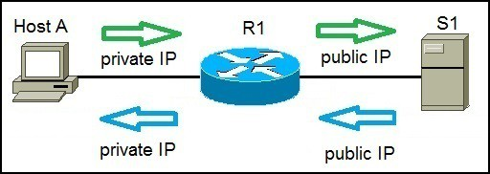
NAT (Network Address Translation)

Slide 13
Host A request a web page from an Internet server. Because Host A uses private IP addressing, the source address of the request has to be changed by the router because private IP addresses are not routable on the Internet. Router R1 receives the request, changes the source IP address to its public IP address and sends the packet to server S1. Server S1 receives the packet and replies to router R1. Router R1 receives the packet, changes the destination IP addresses to the private IP address of Host A and sends the packet to Host A.
There are three types of address translation:
Static NAT – translates one private IP address to a public one. The public IP address is always the same.
Dynamic NAT – private IP addresses are mapped to the pool of public IP addresses.
Port Address Translation (PAT) – one public IP address is used for all internal devices, but a different port is assigned to each private IP address. Also known as NAT Overload.

Slide 14
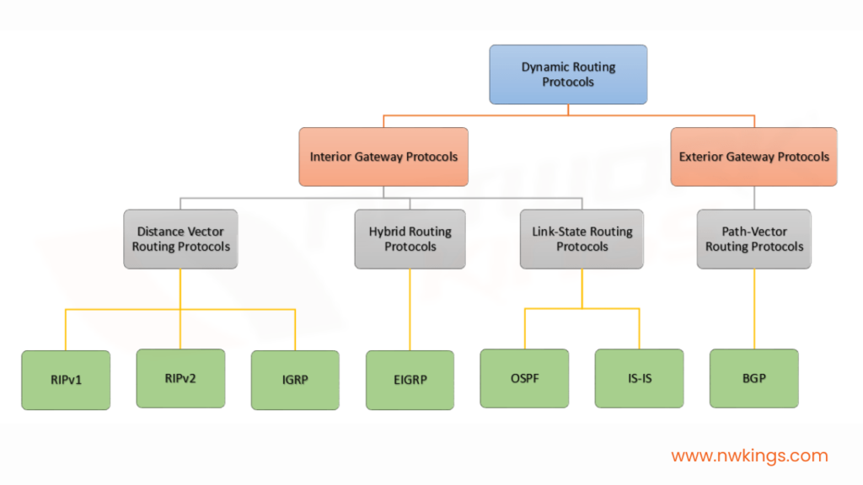
Routing Protocols

Slide 15
Open Shortest Path First (OSPF) in Networking
The OSPF stands for Open Shortest Path First.
It is a widely used and supported routing protocol. It is an intradomain protocol, which means that it is used within an area or a network.
It is an interior gateway protocol that has been designed within a single autonomous system.
It is based on a link-state routing algorithm in which each router contains the information of every domain, and based on this information, it determines the shortest path.
The goal of routing is to learn routes. The OSPF achieves by learning about every router and subnet within the entire network.
Every router contains the same information about the network. The way the router learns this information by sending LSA (Link State Advertisements). These LSAs contain information about every router, subnet, and other networking information. Once the LSAs have been flooded, the OSPF stores the information in a link-state database known as LSDB. The main goal is to have the same information about every router in an LSDBs.

Slide 16
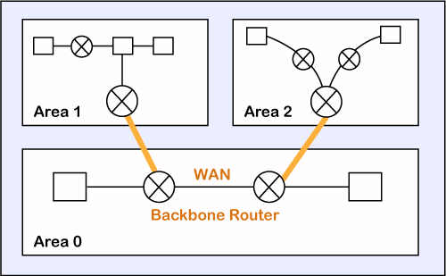
OSPF Areas:

Slide 17
There are three steps that can explain the working of OSPF:
Step 1: The first step is to become OSPF neighbors. The two connecting routers running OSPF on the same link creates a neighbor relationship.
Step 2: The second step is to exchange database information. After becoming the neighbors, the two routers exchange the LSDB information with each other.
Step 3: The third step is to choose the best route. Once the LSDB information has been exchanged with each other, the router chooses the best route to be added to a routing table based on the calculation of SPF.

Slide 18
Types of links in OSPF
Point-to-point link: The point-to-point link directly connects the two routers without any host or router in between.
Transient link: When several routers are attached in a network, they are known as a transient link.
Stub link: It is a network that is connected to the single router. Data enters to the network through the single router and leaves the network through the same router.
Virtual link: If the link between the two routers is broken, the administration creates the virtual path between the routers, and that path could be a long one also.

Slide 19
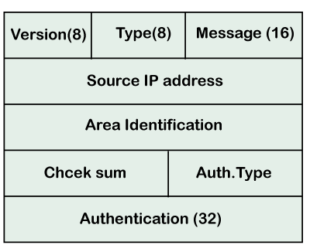
OSPF Message Format
Version: It is an 8-bit field that specifies the OSPF protocol version.
Type: It is an 8-bit field. It specifies the type of the OSPF packet.
Message: It is a 16-bit field that defines the total length of the message, including the header. Therefore, the total length is equal to the sum of the length of the message and header.
Source IP address: It defines the address from which the packets are sent. It is a sending routing IP address.
Area identification: It defines the area within which the routing takes place.
Checksum: It is used for error correction and error detection.
Authentication type: There are two types of authentication, i.e., 0 and 1. Here, 0 means for none that specifies no authentication is available and 1 means for pwd that specifies the password-based authentication.
Authentication: It is a 32-bit field that contains the actual value of the authentication data.

